Slide 1
DISEASE PREDICTION
-BY PRAVALIKA

Slide 2
Objective:
The objective of this project is to develop a predictive model that can accurately classify individuals into diseased or non-diseased categories based on their health attributes.
By leveraging machine learning algorithms, we aim to create a reliable tool that healthcare providers can use to assist in disease diagnosis and prognosis.

Slide 3
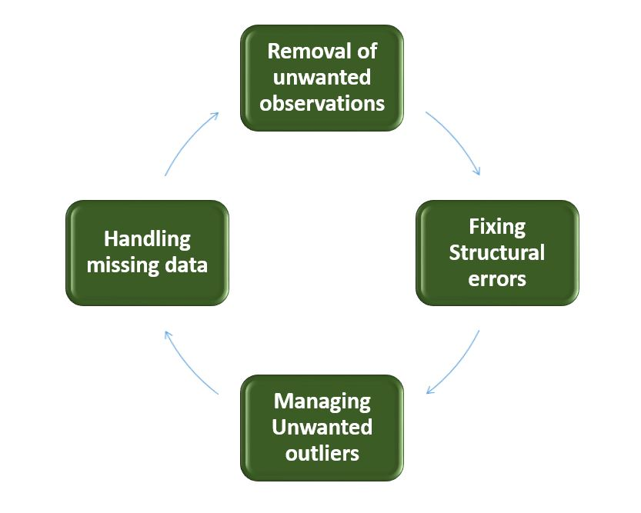
Data cleaning:
Removal of Unwanted Observations: Identify and eliminate irrelevant or redundant observations from the dataset. The step involves scrutinizing data entries for duplicate records, irrelevant information, or data points that do not contribute meaningfully to the analysis.
Fixing Structure errors: Address structural issues in the dataset, such as inconsistencies in data formats, naming conventions, or variable types.
Managing Unwanted outliers: Identify and manage outliers, which are data points significantly deviating from the norm. Depending on the context, decide whether to remove outliers or transform them to minimize their impact on analysis.
Handling Missing Data: Devise strategies to handle missing data effectively. This may involve imputing missing values based on statistical methods, removing records with missing values, or employing advanced imputation techniques.

Slide 4
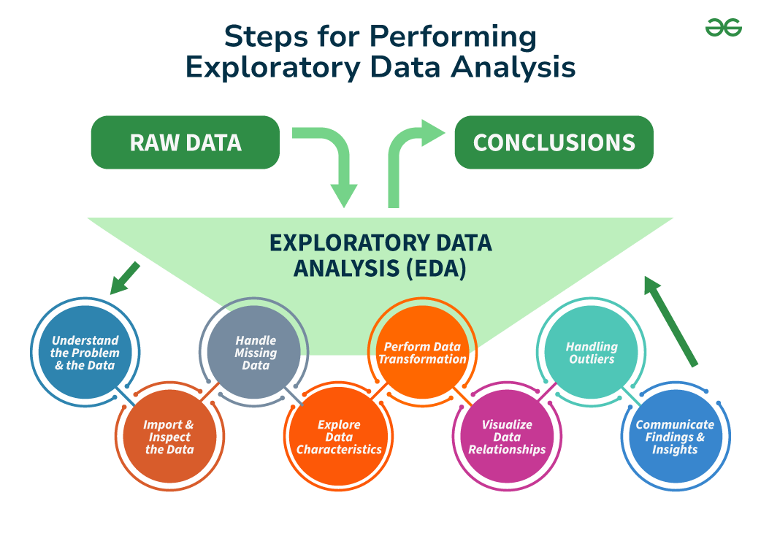
EDA:

Slide 5
Types of Exploratory Data Analysis:
Univariate Analysis:
Histograms: Used to visualize the distribution of a variable.
Box plots: Useful for detecting outliers and understanding the spread and skewness of the data.
Bar charts: Employed for categorical data to show the frequency of each category.
Summary statistics: Calculations like mean, median, mode, variance, and standard deviation that describe the central tendency and dispersion of the data.
Bivariate Analysis:
Scatter Plots: A scatter plot helps visualize the relationship between two continuous variables.
Correlation Coefficient: This statistical measure (often Pearson’s correlation coefficient for linear relationships) quantifies the degree to which two variables are related.
Multivariate Analysis:
Pair plots: Visualize relationships across several variables simultaneously to capture a comprehensive view of potential interactions.
Principal Component Analysis (PCA): A dimensionality reduction technique used to reduce the dimensionality of large datasets, while preserving as much variance as possible.

Slide 6
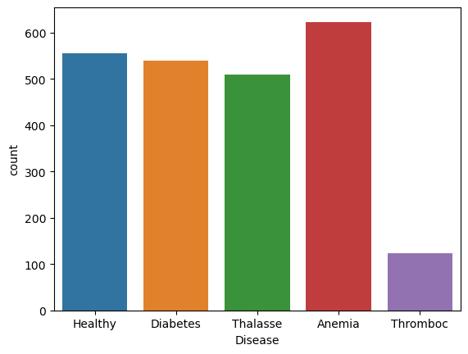
Count plot of disease:

Slide 7
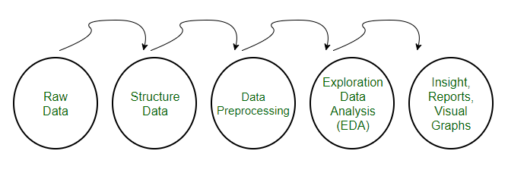
Data Preprocessing:
Pre-processing refers to the transformations applied to our data before feeding it to the algorithm. Data preprocessing is a technique that is used to convert the raw data into a clean data set. In other words, whenever the data is gathered from different sources it is collected in raw format which is not feasible for the analysis.

Slide 8
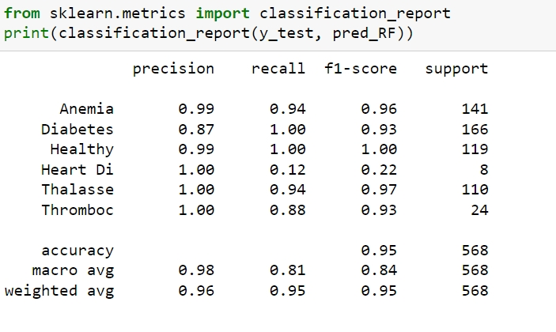
Model building:
For build a model I have used classification methods like logistic regression, support vector machine, k-nearest neighbors (KNN) and random forest.
Out of all these models I have better performance in random forest model. i.e., 95% of accuracy.
Random forest has the clear observation among the disease prediction analysis and has given the deeper insights of the dataset.

Slide 9
Conclusion:
Random Forest Regression is a highly versatile and reliable model for predicting outcomes in disease prediction task. Its ability to handle non linearity and its resistance to over-fitting makes it an ideal choice for many predictive applications.
Over all the random forest model is the best choice for making predictions on the multiple diseases.
Random Forest is an example of ensemble learning where each model is a decision tree. Ensemble learning creates a stronger model by aggregating the predictions of multiple weak models, such as decision trees.

Slide 10
THANK YOU

